Slide 1



BLAZING THE TRAIL IN FUNCTIONAL BEER

Slide 2
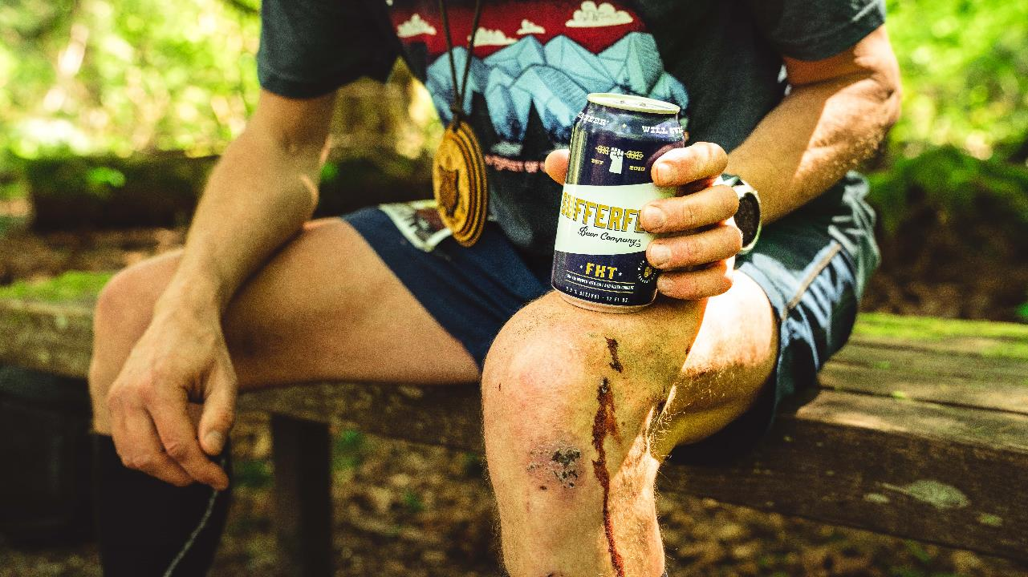
WHAT IS A SUFFERFEST?
/SUF-FER-FEST/ noun:
An activity whereby all participants ache, agonize, ail, deteriorate, endure and languish, but by co-misery will have experienced a grand time

Slide 3


ABOUT US
Origins: Inspired by athletes and a healthy lifestyle, Caitlin Landesberg started Sufferfest in 2016.
Functional Beer: Category focused on beer purpose-brewed with high-quality ingredients to enhance the flavor and add to your enjoyment.
Consumers: The Sufferfest brand attracts healthy, active and socially conscious consumers that are highly loyal and athletically engaged. They love to sweat, suffer and celebrate!

Slide 4



Brand Overview
WHO IS SUFFERFEST?
Sufferfest Beer Company is a woman founded certified B Corporation who crafts beer inspired by those who aspire to live healthy, active lifestyles. We are the pioneer of purpose-brewed craft light beer made with exotic ingredients that add flavor complexity.

Slide 5

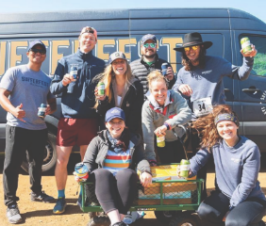
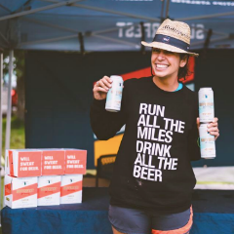
SUFFERFEST BRAND OVERVIEW
THE WHY?
Sufferfest was founded to satisfy the need for the perfect finish line beer —something that spoke to active and healthy consumers who cared about what they put into their bodies. At a time where “better for you” food options are crowding the shelves, the “functional beverage” category continues to lead as the fastest growing sub-category.

Slide 6
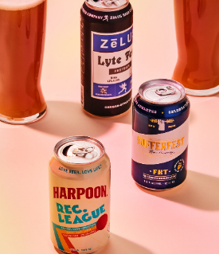
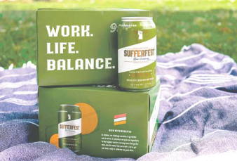
INDUSTRY TRENDS TOWARDS FUNCTIONAL & WELLNESS
How Low-Alcohol Beers Became Brewing's Next Big Thing
  “While the average craft beer drinker might not realize it, big breweries see huge potential for their low-calorie, “active lifestyle” beers.”
Bernot, K. (2018, November 2). “How Low-Alcohol Beers Became Brewing’s Next Big Thing. Retrieved from www.thrillist.com.
Breweries Are Trying to Make Beer Healthier
  “‘Low or no alcohol is of interest to many brewers especially in the US because wellness is a huge facet that’s driving a lot of consumer packaged goods sales,’ Julia Herz, the craft beer program director at the Brewers Association, told MarketWatch. ‘Wellness and health is a big deal and many people are taking a look at their beverage alcohol consumption.’”
Settembre, J. (2019, March 11). Breweries Are Trying to Make Beer Healthier. Retrieved from www.nypost.com.
Craft Brewers Lighten Up and Take Aim at the ‘Sweaty Consumer’
  "From Day 1, we focused on the ‘sweaty consumer,’” she said. “There is that demographic that is the millennial person who votes with dollars, who wants to have something that’s new and indulgent but understands their health-conscious lifestyle, and that sweaty consumer is a tribe that I’m a part of and speak to and sweat with.”
  Sedacca, M. (2019, May 26). Craft Brewers Lighten Up and Take Aim at the ‘Sweaty Consumer.’ Retrieved from www.nytimes.com.

Slide 7
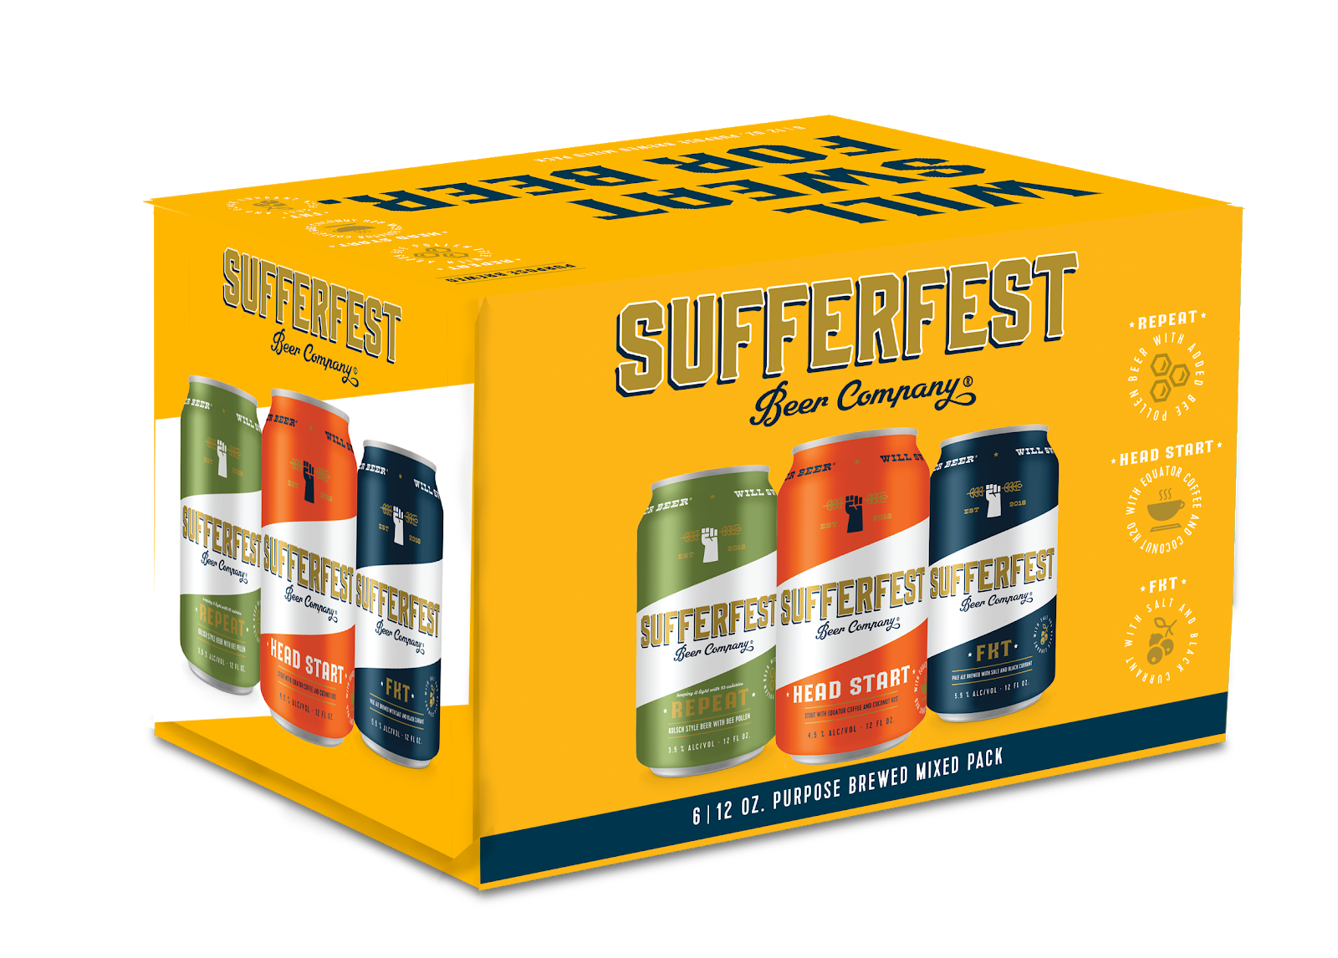
VARIETY PACK
New Variety Pack
6-pack 12oz cans
Repeat Kolsch
FKT Pale Ale
Head Start Stout
Why a Variety Pack?
Introduce drinkers to a new category & encourage trial & feedback
This demographic is used to buying variety packs – “represents 2/3 of total hard seltzer sales”*
Case 1: $36.80 ($12.99)
3+: $30.80 ($9.99)
*Source: Beer Marketer’s Insights 5.20.19
Notes:
Sufferfest Beer Company is a woman founded, certified B Corporation who crafts beers for people who want to live healthy, active lifestyles. Their flagship product is a 95 calorie, 2.6 carb beer made with bee pollen but they also make a range of beers like a 135 calorie stout with coconut milk and a 175 calorie pale ale with black currants.

Slide 8
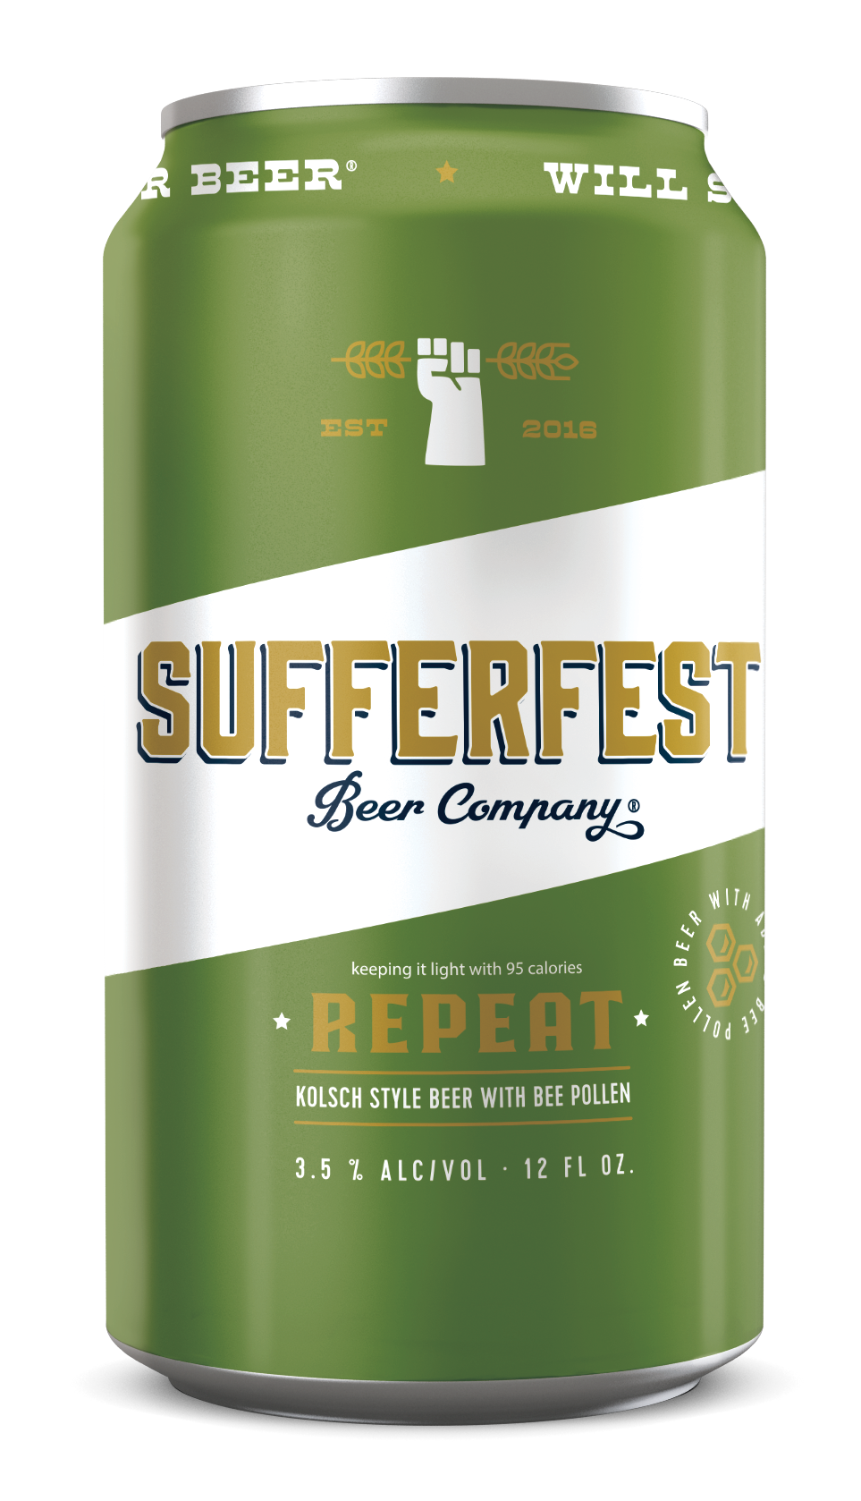
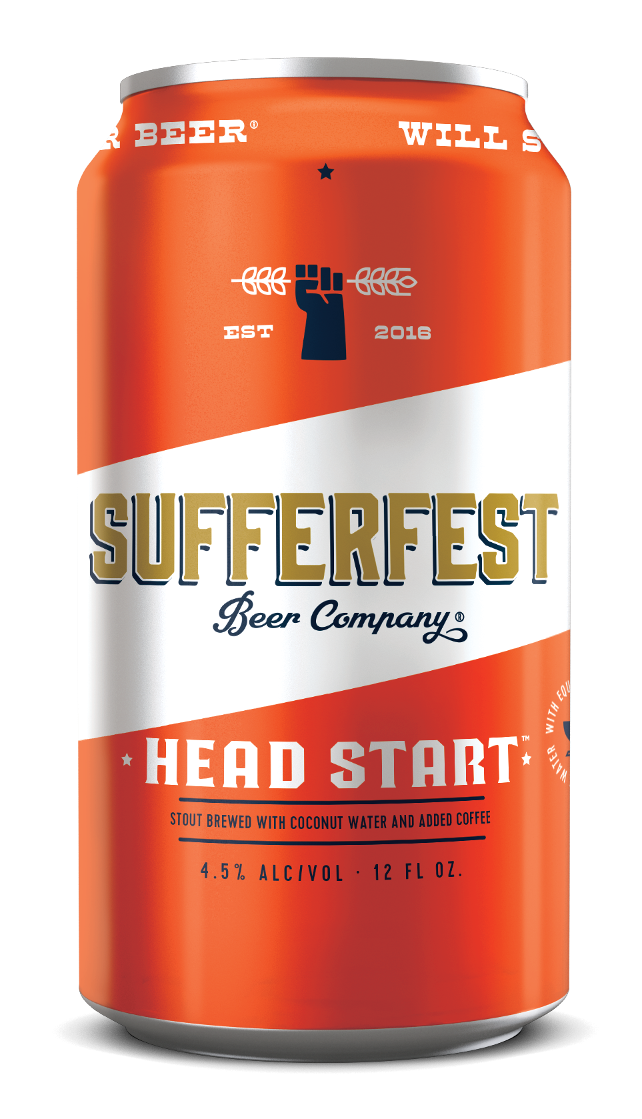
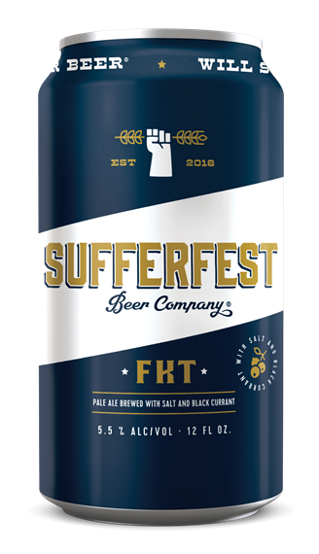
THE BEERS
REPEAT KOLSCH
Brewed w/ Bee Pollen
HEAD START STOUT
Brewed w/ Coconut Water & Equator Coffee Added
FKT PALE ALE
Brewed w/ Black Currant & Salt
ABV: 3.5%
IBU: 25
95 calories, 5G carbs
Gluten: <10PPM
Variety Pack, 6pk & Draught
ABV: 4.5%
IBU: 20
135 calories
Gluten: <10PPM
Variety Pack & Draught
ABV: 5.5%
IBU: 40
175 calories
Gluten: <10PPM
Variety Pack & Draught

Slide 9

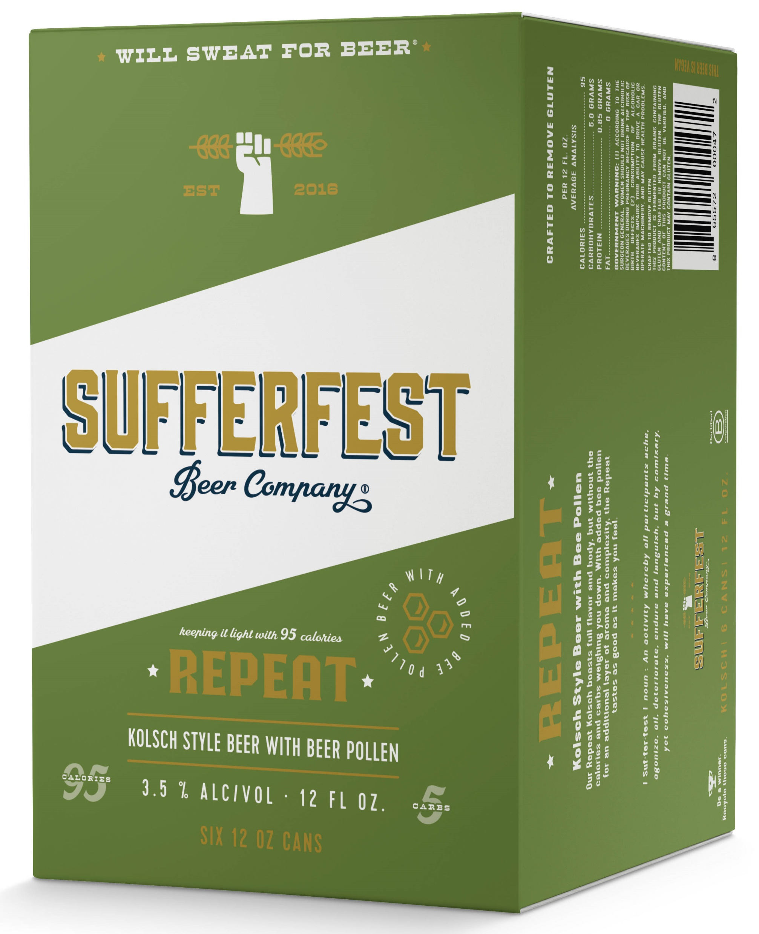
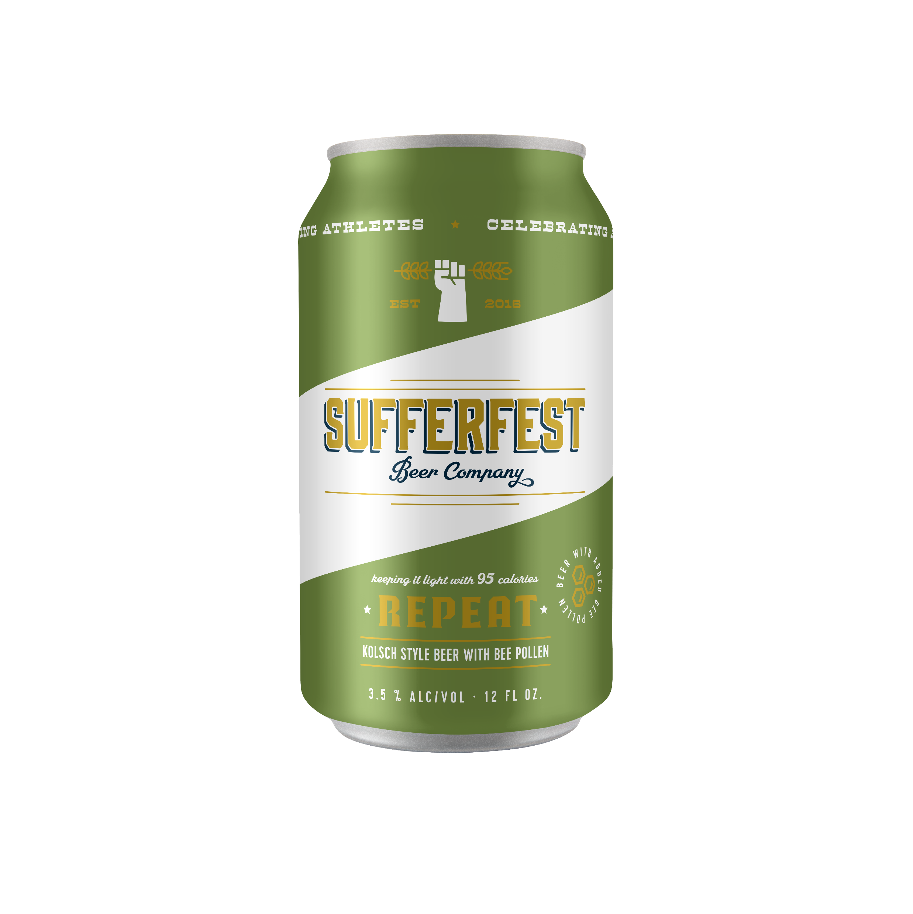
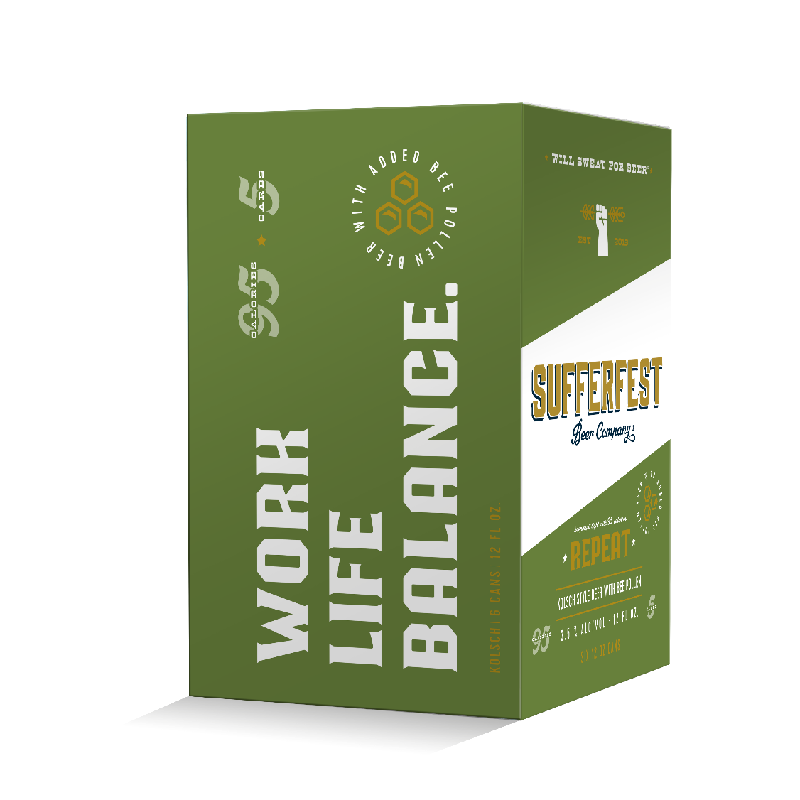
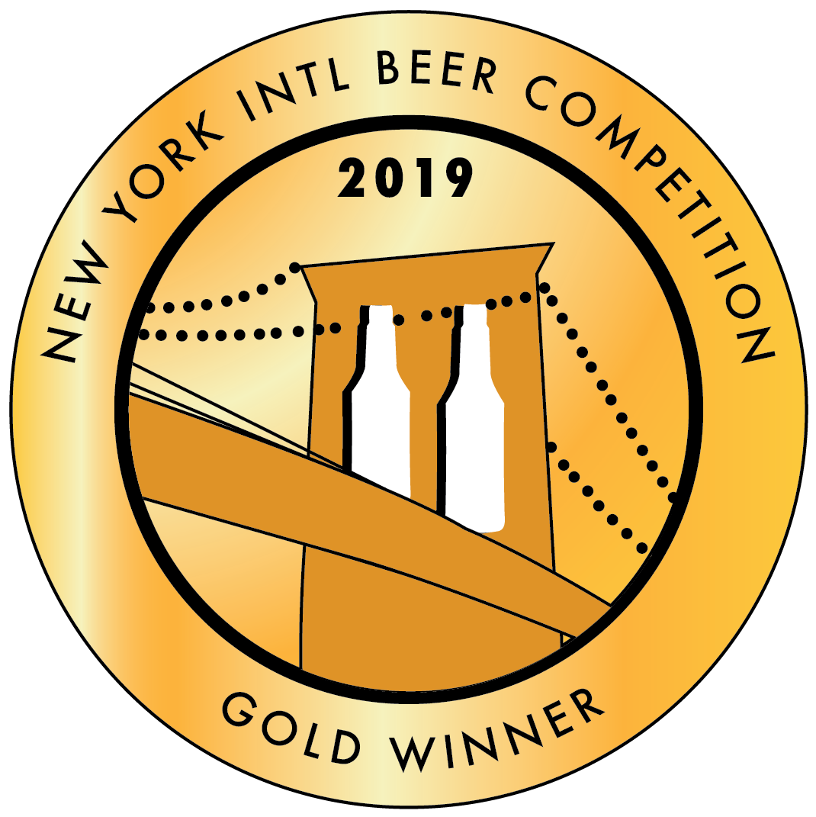
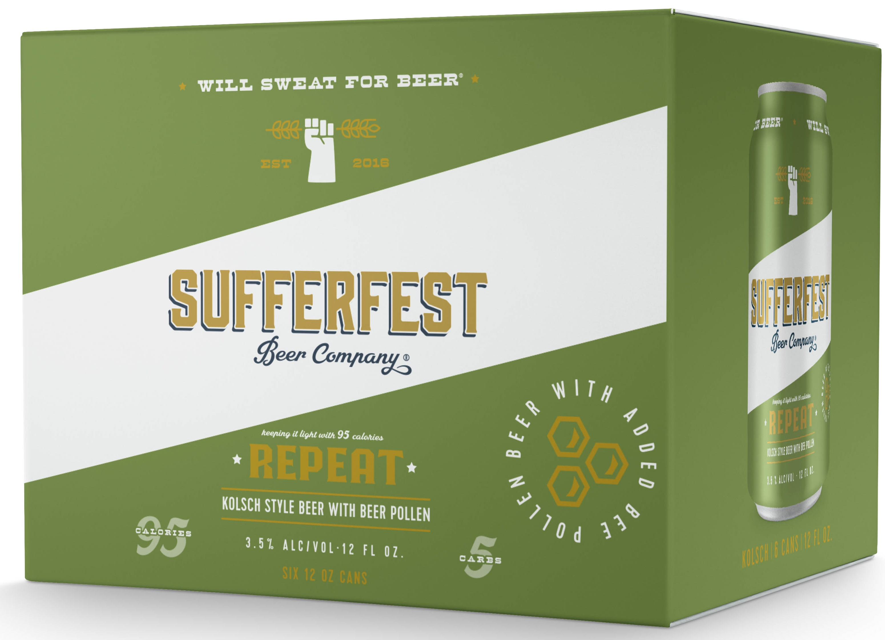

KETO DIET FRIENDLY
LOW CAL
LOW CARB
AWARD WINNING
REPEAT KOLSCH
Brewed with Bee Pollen
Our flagship Repeat Kolsch boasts full flavor and body, but without the calories and carbs weighing you down. With added bee pollen for an additional layer of aroma and complexity, the Repeat is here to celebrate work, life, balance.
ABV: 3.5%
IBUS: 25
GLUTEN < 10 PPM
95 CALORIES, 5G CARBS
INNOVATION: BEE POLLEN
HOPS: SAAZ, CITRA, AZACCA, MAGNUM
KEGS AVAILABLE

Slide 10
BRAND STANDARDS
Positioning
  Craft 6pk can shelf and door. Adjacent to other purposeful brands.
  Emerging Functional Set or “Better For You Door”
SUFFERFEST
HARD SELTZER AND CIDERS
SIERRA NEVADA DOOR
CRAFT
BEER
CRAFT
BEER

Slide 11
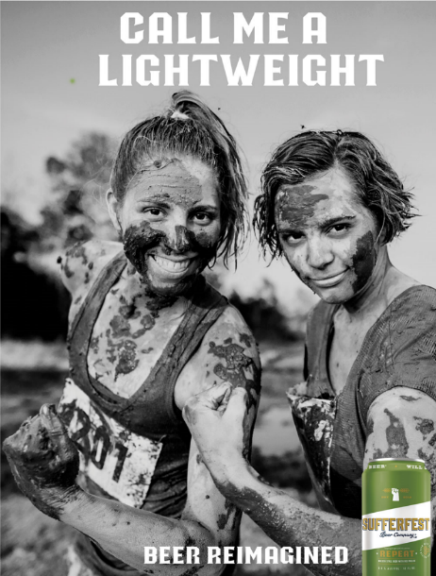
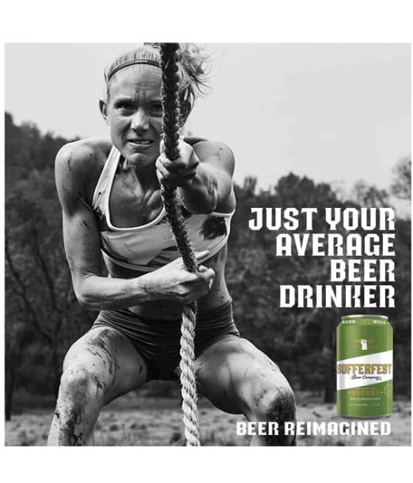
CAMPAIGN CREATIVE

Slide 12
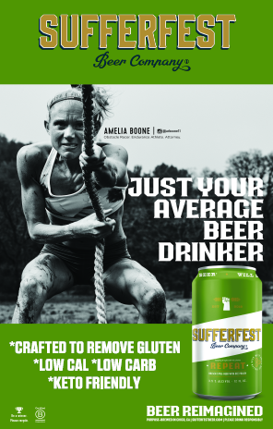
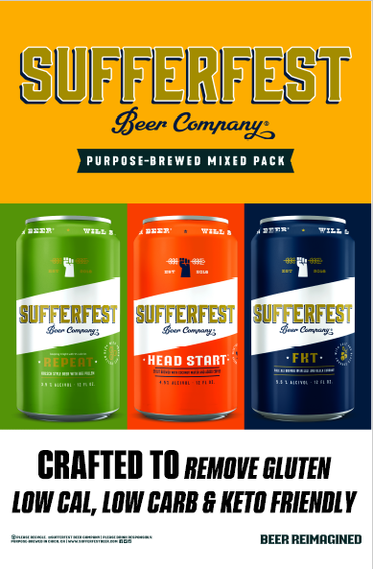
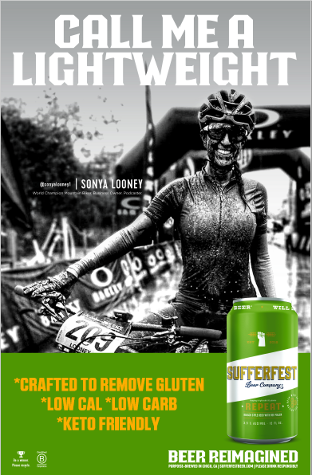
DAHLHEIMER IN HOUSE POS

