Slide 1
Brand advocate program
Brand awareness / sales / field-quality support network comprised of highly-educated and well-rounded beer professionals.

Slide 2
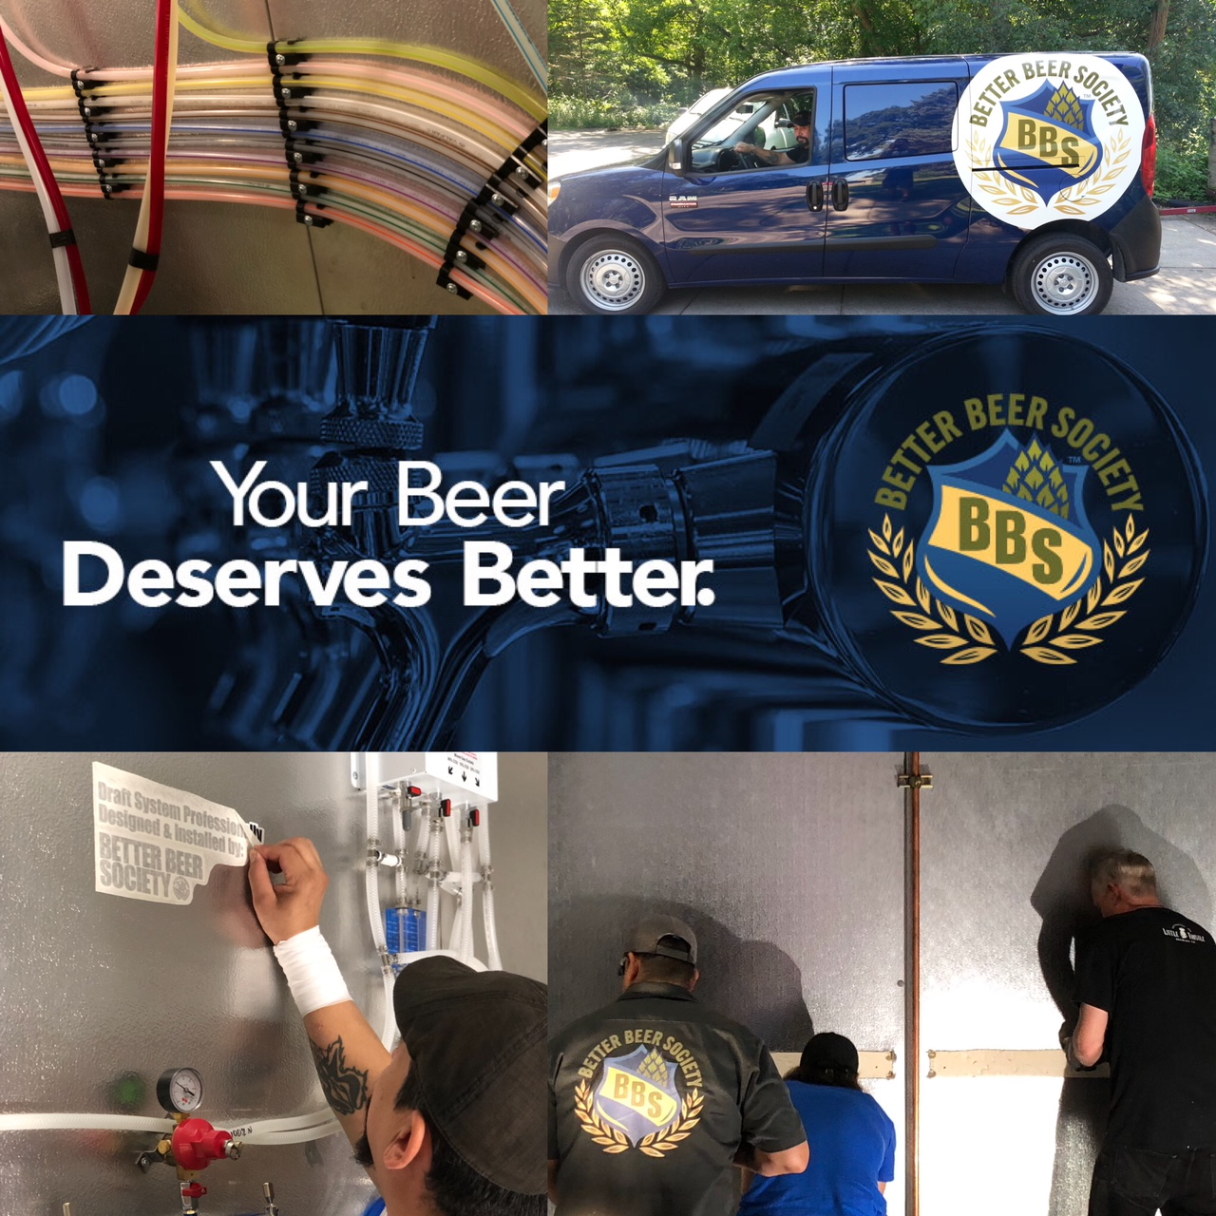
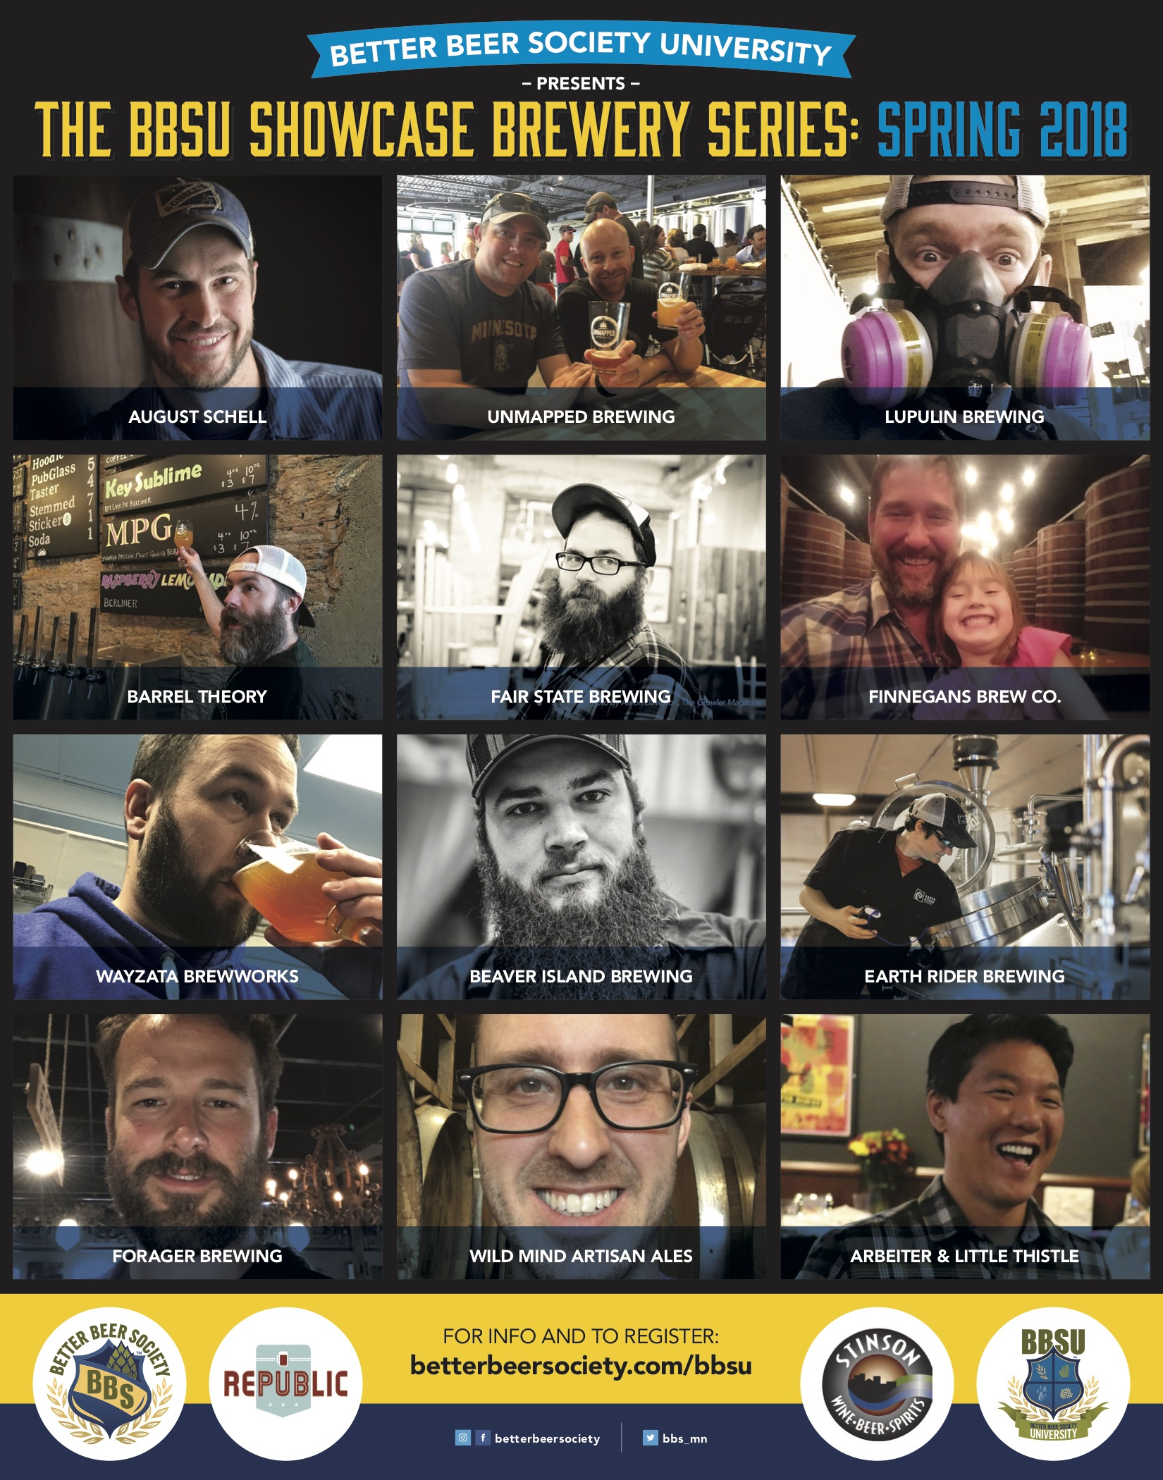
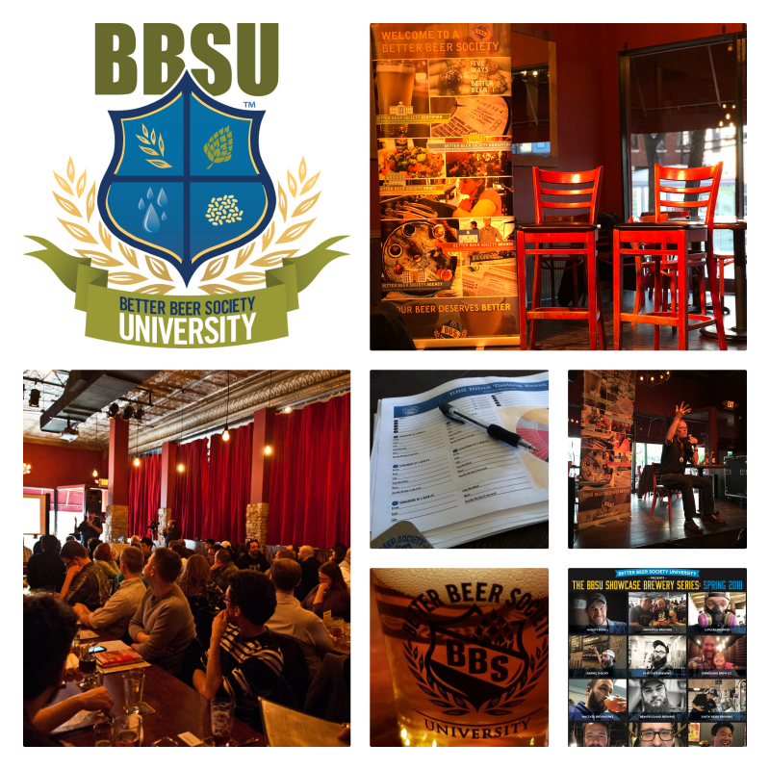
Our Story
Our story is a fairly simple one.
We are a team of industry professionals and Certified Cicerone’s who have chosen a path to help further educate and implement best-practices for our industry and beer communities. Our programs range from QA/QC, Draft System Design, Installation & Repair, ongoing Draft Maintenance / Beer Line Cleaning, as well as furthering education through FOH staff training, educational consumer and industry-exclusive events, and much more.
As we come from the industry, we have a great understanding and deep appreciation for it, including the challenges most breweries face with beer sales.
As a result, we created an entirely unique program, one that is centered around knowledge and quality and has been met with high praise from our industry peers. We hope you like what you see.

Slide 3
the new world of beer sales.
OLD WAY
Hire 1-2 Market Managers
Develop an internal Street Team
Manage Street Team
Maintain Relationships/Placement
Grow/Expand Awareness in Territories
NEW WAY
Hire a Sales Manager
Invest in sales team(s)
Align with professional network (BBS)
Provide healthy work environment
Increased retention / sales growth
Better Beer Society allows your sales team to do what you hired them to do best…to SELL. We are in an increasingly competitive market. One that requires every moment of your time invested in maintaining relationships and not managing an internal team of beer enthusiasts. In today’s world, this is an exhaustive amount of work just maintaining your brand awareness and offering retailer support in both the on and off-premise.
Our program gives you the peace of mind that you’re continuing to grow brand awareness, maintain relevancy, and allow your sales force the opportunity to be in 5, 10, 15, places at once, while giving your market managers those precious hours to focus on relationships, sales growth, or other strategic plans within your brewery.

Slide 4
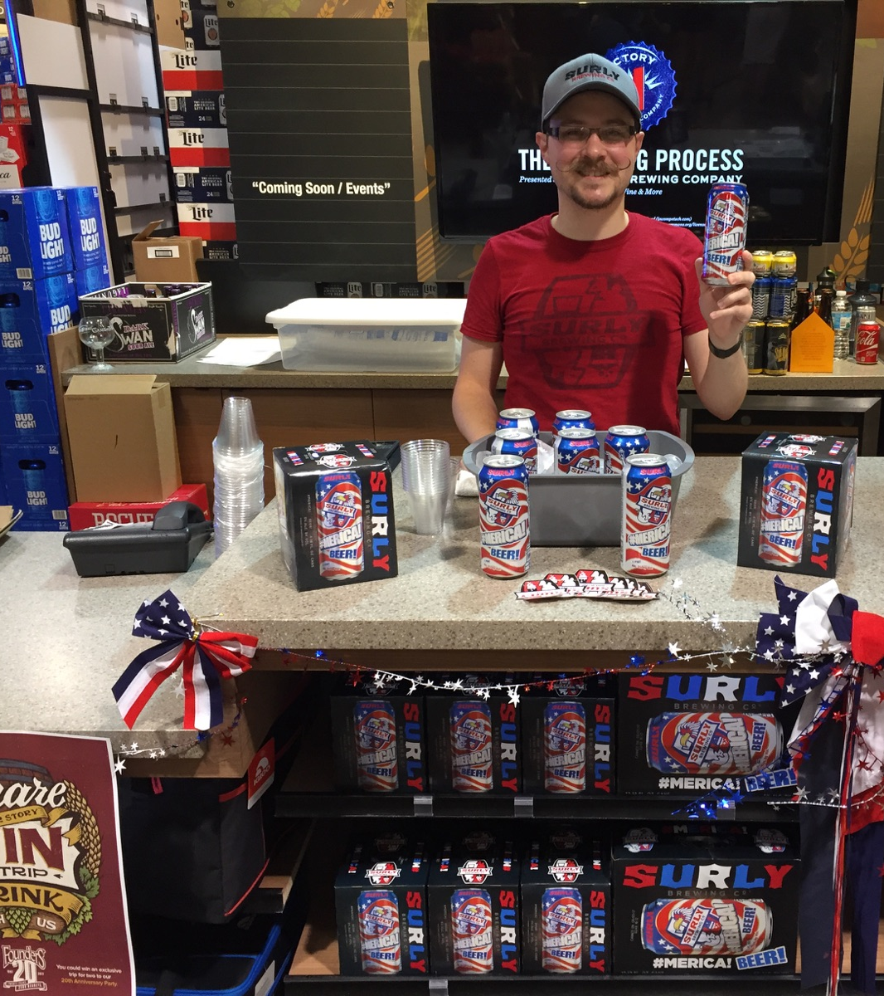
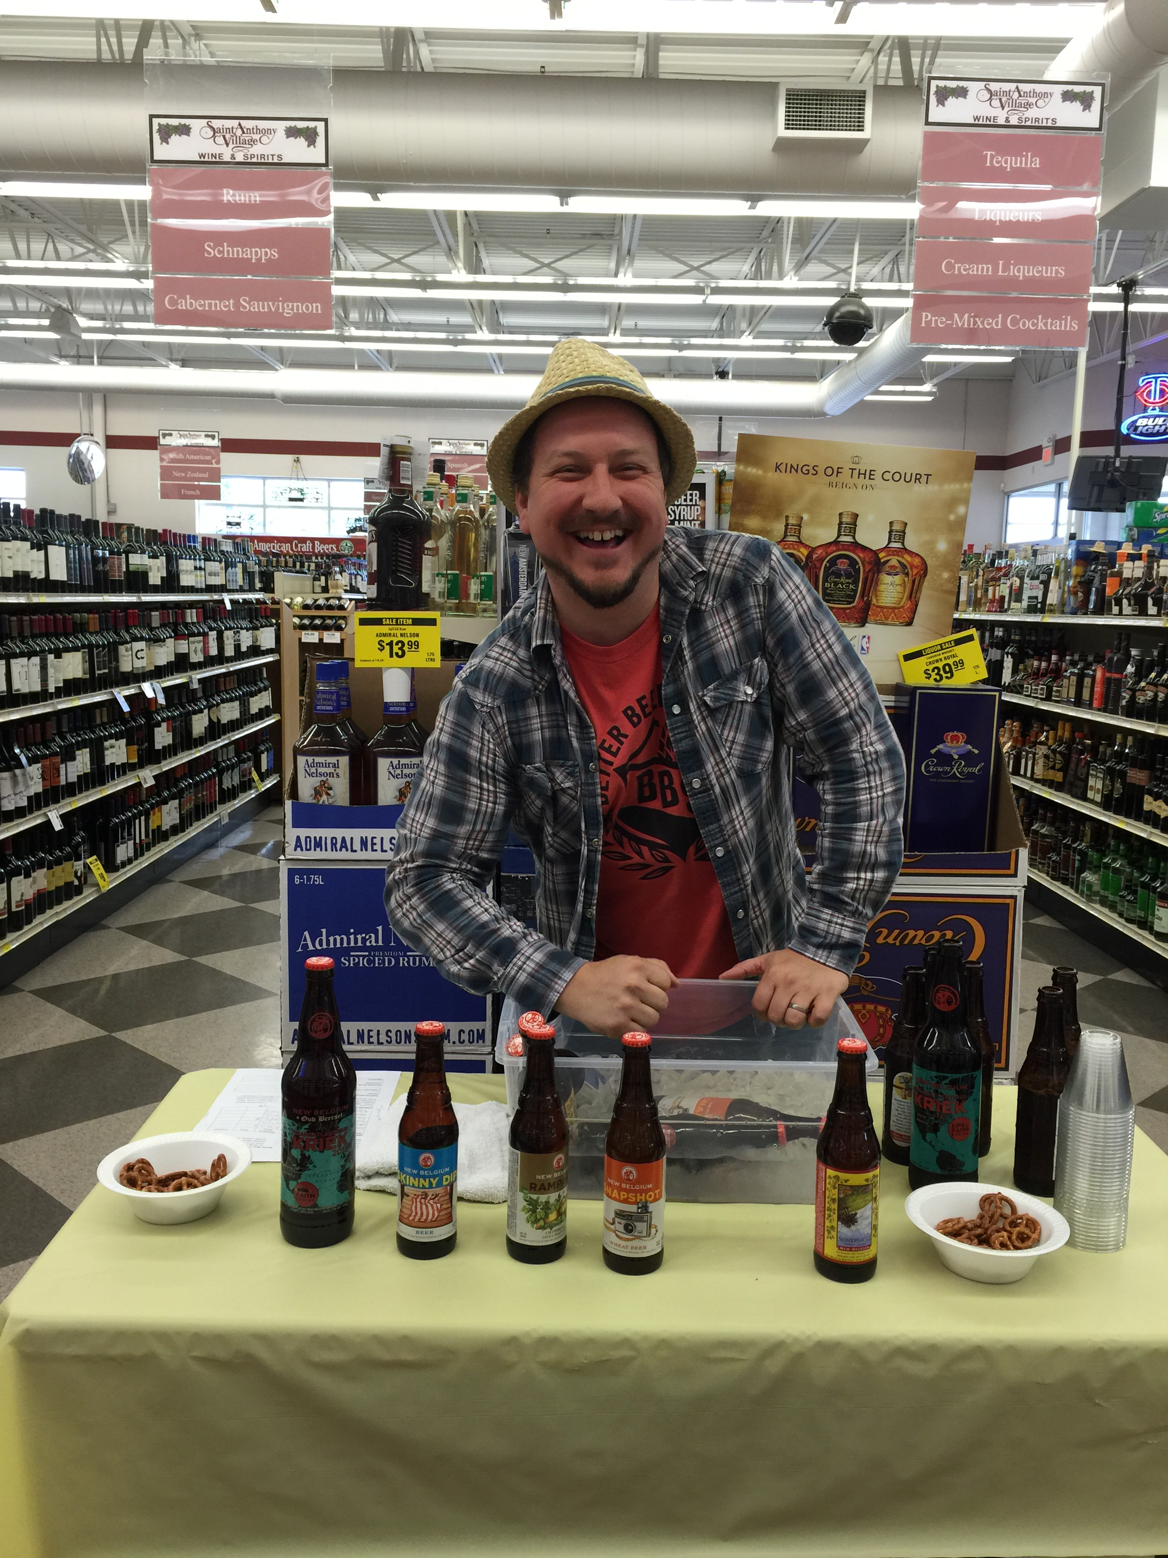
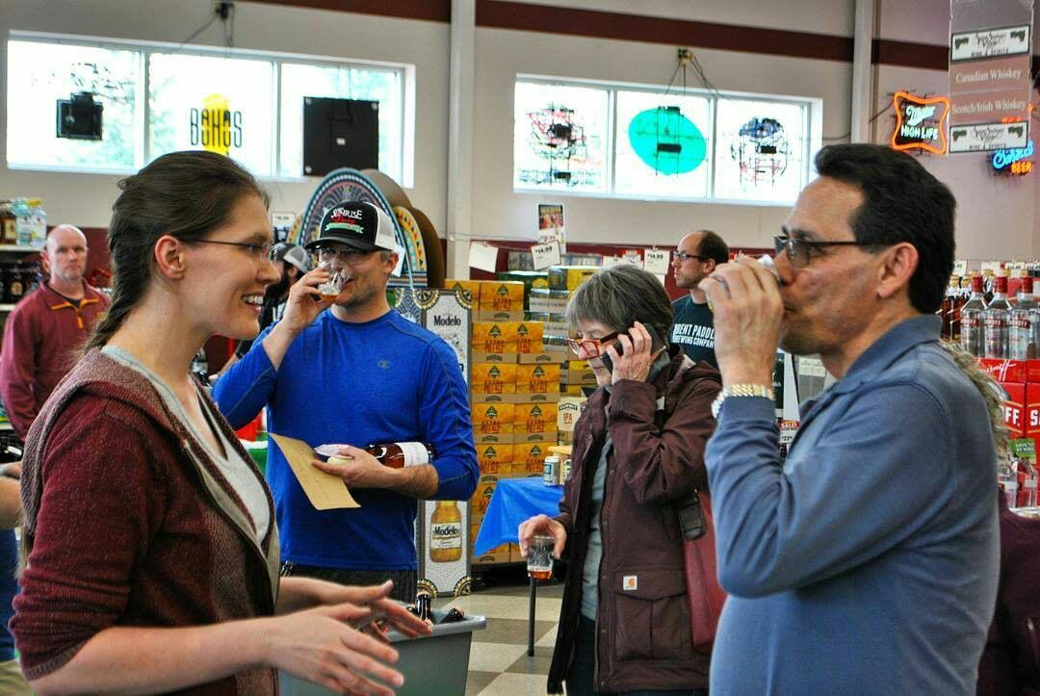
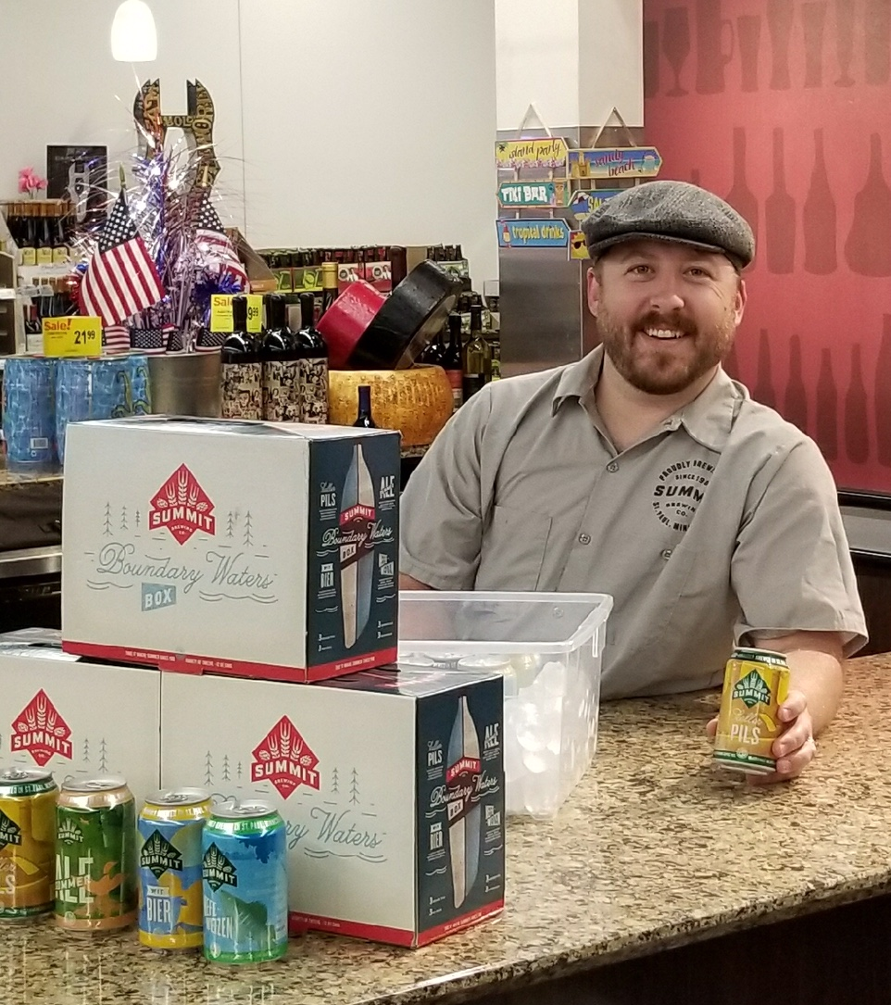
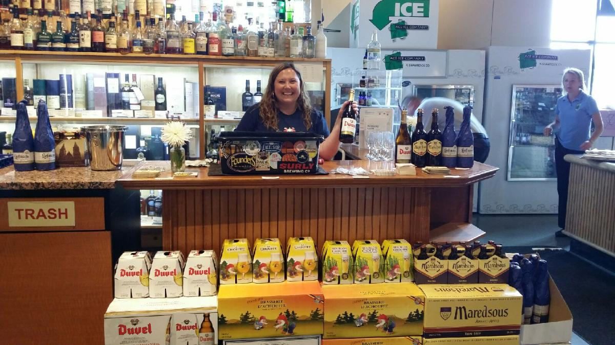
Meet our team
RELIABLE
EFFECTIVE
KNOWLEDGEABLE
PROFESSIONAL
ON-BRAND
PERSONABLE
ALL BA’S ARE CERTIFIED BEER SERVER* STATUS AT A MINIMUM
(*Cicerone Certification Program)

Slide 5
advantage
Training
Initial hands-on training with brewery
Monthly internal training (sales strategies, style profiles, process, ingredients, field quality, etc.)
Detailed Reporting
Sales / Sell-through reports
Qualitative / Quantitative Data
Impressions / Consumer Interactions
Inventory Placement / Rotation
Built-in Network
Ability to be in 15+ places at once. We have teams across Minnesota, as well as Milwaukee, Madison, Chicago, Chicagoland suburbs, Indianapolis, South Bend, and Fort Wayne.
Results
High conversion % of impressions to sales.

Slide 6

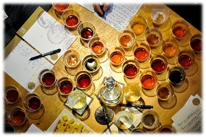
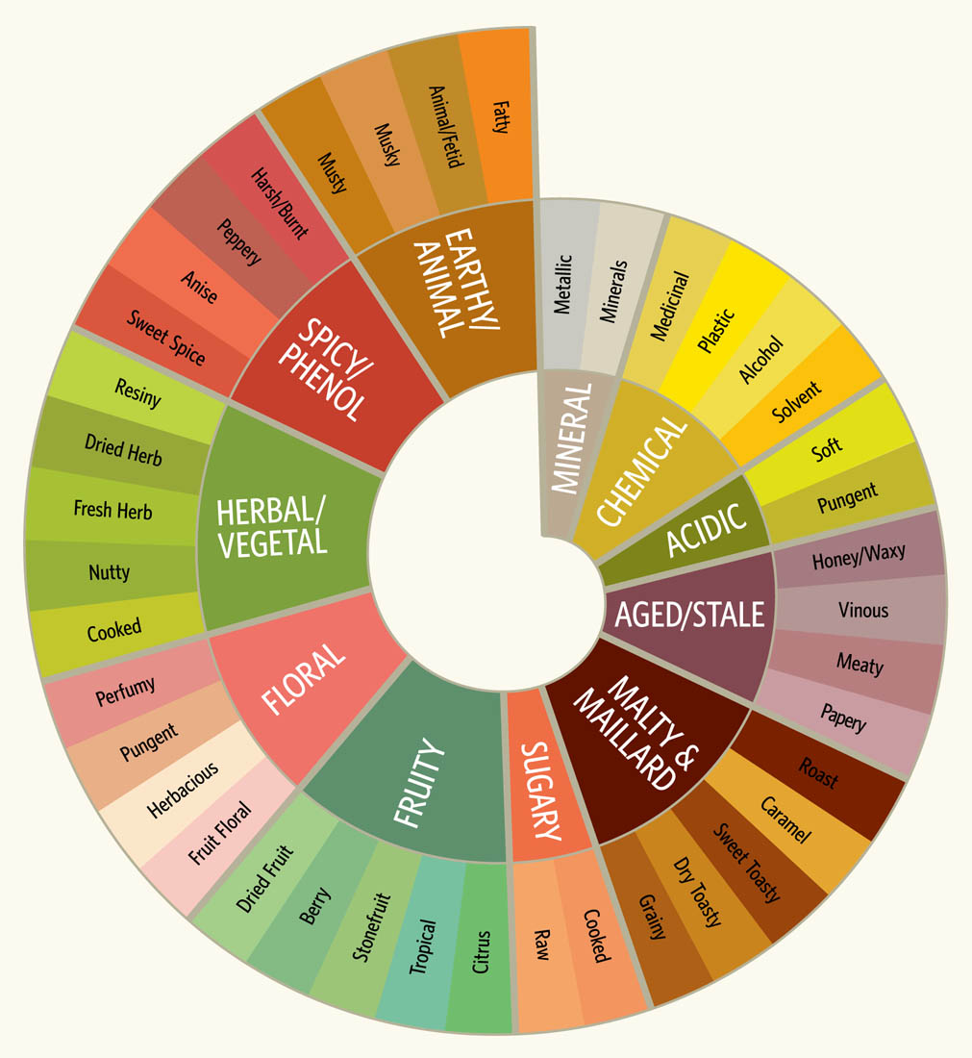
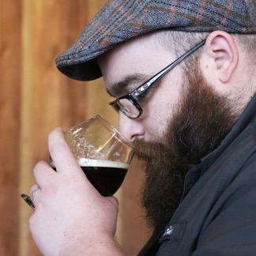
Ongoing Training
Led by Certified Cicerone® and BA Program Director, Kate Linge Roed, our BA’s receive ongoing training on topics that help shape them into well-rounded beer professionals. Topics range from sales strategies and consumer demographics, brewing process, deconstructing beer ingredients, as well as better understanding flavor and articulating this to the consumer.

Slide 7
Reporting
Detailed sampling report that illustrates the event from start to finish, providing a snapshot of everything from the amount of store traffic and consumer impressions, to the amount of beer purchased (by our team) and most importantly the amount of beer sold to the public.
We recognize this type of qualitative and quantitative data is invaluable to our partners. BBS is committed to improving and growing this side of the business to continue bringing you this value and adding to our distinction.
SAMPLE REPORT

Slide 8
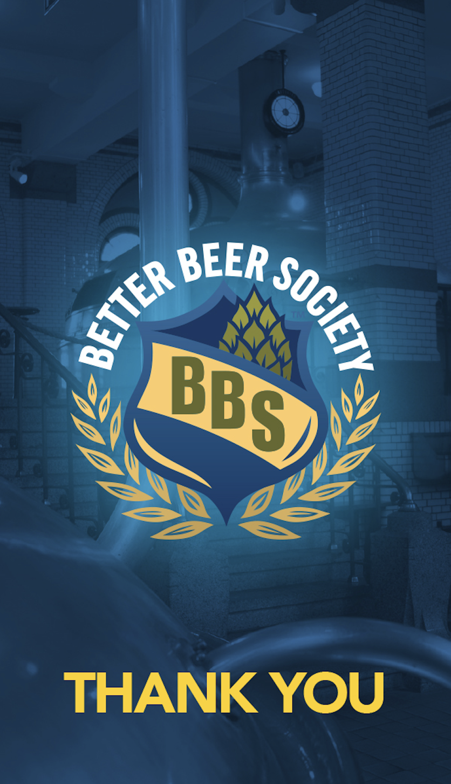
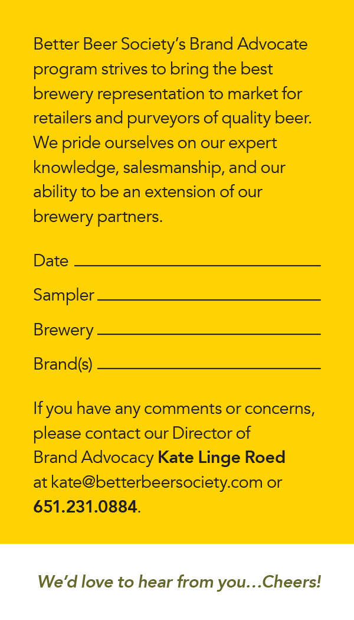
Comment cards
In an effort to hold our team and high-quality standards accountable, we leave these comment cards after each sampling event with the owner or management and encourage feedback.
We want constant feedback.
We’re always improving.
We are completely transparent.
We hold ourselves accountable.
We take great pride in our team.

Slide 9
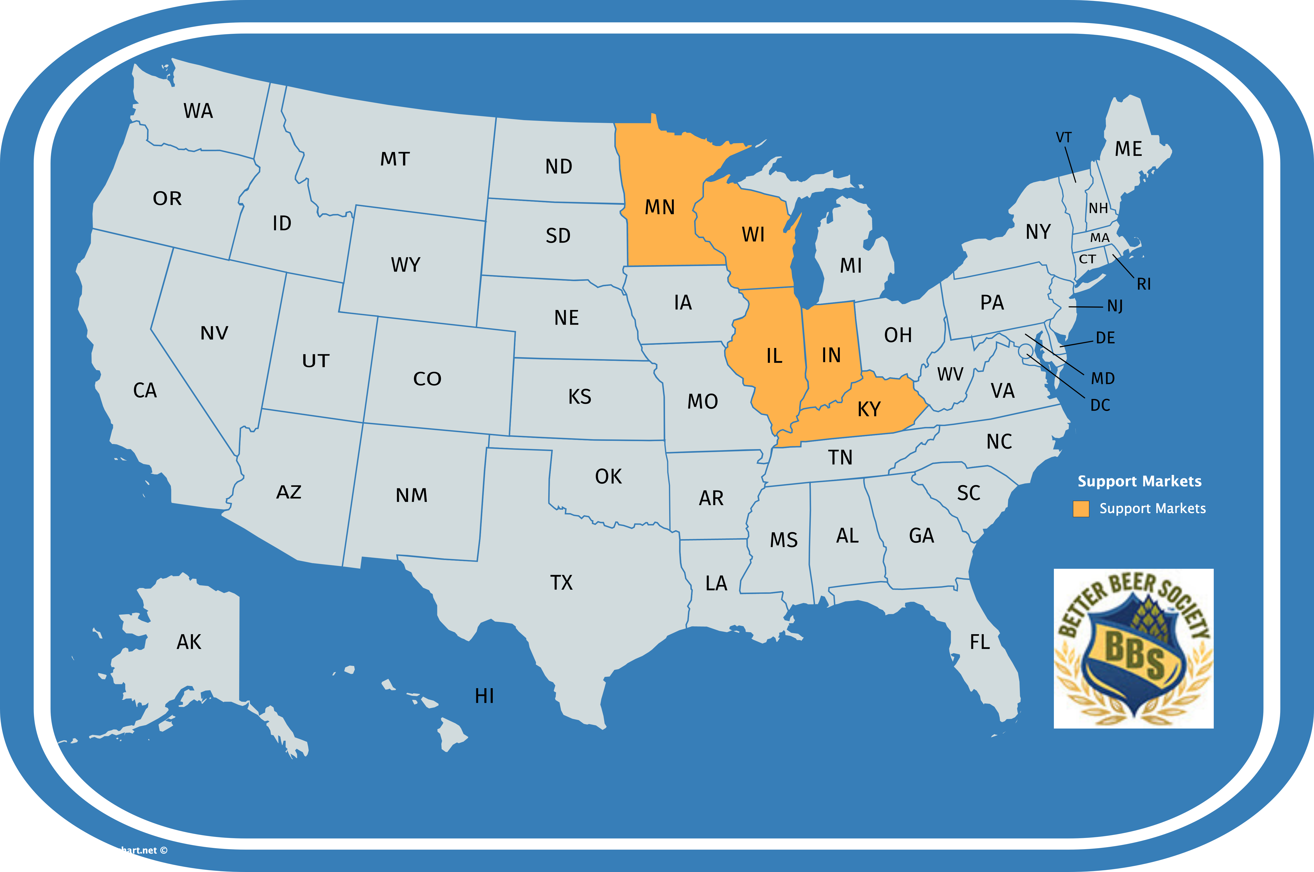
Support map
Minnesota support:
Twin Cities, Duluth, Rochester, St. Cloud
Wisconsin support:
Madison, Milwaukee
Illinois support:
Chicago, Chicago suburbs
Indiana support:
Indianapolis, Ft. Wayne, South Bend
Kentucky support: Coming Soon

Slide 10
Testimonials
"Better Beer Society and their Brand Advocates are true professionals. If it’s not the brewery rep hosting the event, they are the ONLY outside agency I allow to do tastings at France 44." - Bill Nosan / Buyer & Manager / France 44 Wines & Spirits
“Better Beer Society continues to be an extremely valuable partner to us. Their Brand Advocate program has proven to be quite effective in supporting and building our brands" - Ryan Ferebee // Beverage Specialist & Certified Cicerone® // Breakthru Beverage
"We've been partnered with Better Beer Society's BA Program for years. Their team not only has great knowledge of our brewery and brands, but of beer in general. They are a well-trusted service, not only from us and other suppliers, but also to our retail partners. Their ability to staff all of our requests and provide us with detailed recaps has made this relationship extremely valuable to us.” – Corland Egertson / Regional Sales Manager // Odell Brewing Co.
"Better Beer Society's continued commitment to creativity, quality, and education for the beer consumer are just some of the many reasons why we choose to work with them. We raise a glass to all that they do for our industry." - Ian Meredith / Off-Premise Metro Sales Manager // Summit Brewing Co.
“I have worked with BBS for almost 5 years now. Without a doubt, they are the most outgoing, friendly, reliable, and knowledgeable team I have ever worked with. When it comes to trusting someone else to represent your brand, there is no one else I would choose to partner with.” – Stephen Cregan / Sierra Nevada Brewing Co.
“We work with Better Beer Society in multiple states. They have proven to be a highly professional and process driven partner for us. They're extremely easy to work with and willing to adjust to the needs of our brands when asked. Moreover, their teams are reliable, consistent and highly effective for us. ” - Jason McMackins // Manager, Consulting // Baker Tilly Virchow Krause, LLP

Slide 11
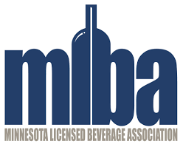




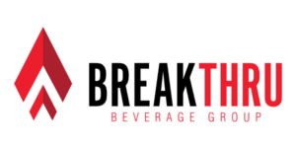

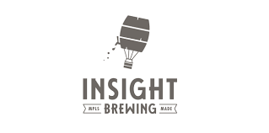
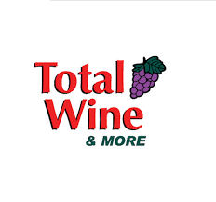


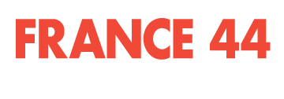
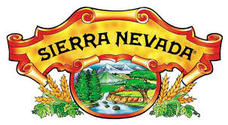

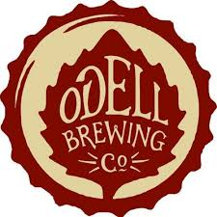

BBS partners (Partial list)

Slide 12
pricing / terms
We’re pretty transparent in saying that this program isn’t designed for BBS to heavily profit. We realize the value that we bring, but our pricing remans competitive with other 3rd party, model/promotional agencies, as we have other programs and divisions that help sustain our company’s growth and mission.
We choose to pay our BA’s a fair wage and invest most of our profits right back into their continued education and further growth of the program, which, in turn, brings that added value right back to you with market expansions, hiring management, field quality audits, new programs, etc.
Our logic (and satisfaction) being that BBS is supporting the industry in numerous ways. We’re investing back into the beer community, developing beer professionals, investing in beer education, and elevating the consumer experience on your brewery’s behalf. Ideally that means something to you. We hope you’ll support us in-kind.
TERMS / PRICING
$50 per hour (2-hour minimum)
2 week notice of bookings preferred
4 sampling events per month (currently not limited to 1 market)
Swag / Outfitting for BA’s (subject to brewery budget)

Slide 13



Thank you.
www.betterbeersociety.com

